Slide 1
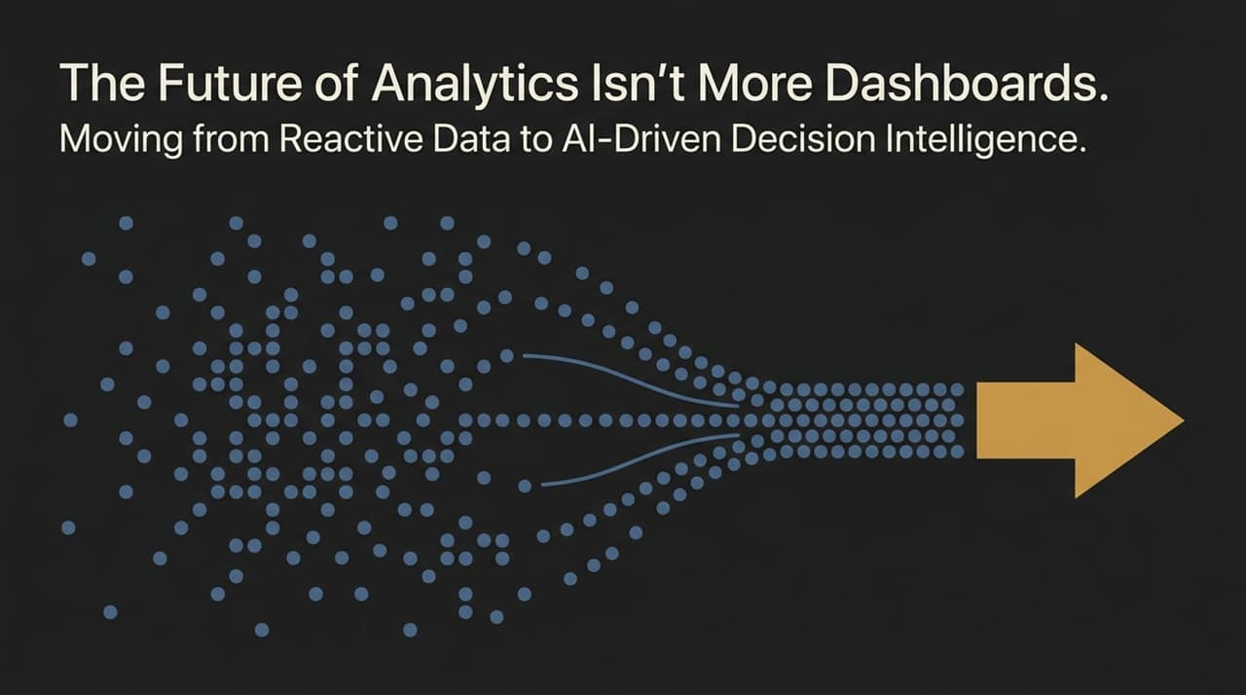
Notes:
Welcome, everyone. When most people think about data analytics or enterprise intelligence, what usually comes to mind first? It’s charts, numbers, complex spreadsheets, and rows of colorful dashboards built in Power BI or Tableau. But today, we want to ask a fundamental question: What happens after the dashboard is created?
Having access to data and actually knowing what to do with that data are two entirely different things. You can build the most detailed, visually stunning dashboard in the world, but if your decision-makers can't interpret what the data is telling them or act on it quickly, you’re utilizing only a tiny fraction of your data’s true potential.
Today, we’re looking beyond the static dashboard. We're moving from reactive data display to AI-driven decision intelligence—shifting from 'show me the numbers' to 'tell me what action to take next'.
https://www.youtube.com/watch?v=7gZ3a3Uwv3Q

Slide 2
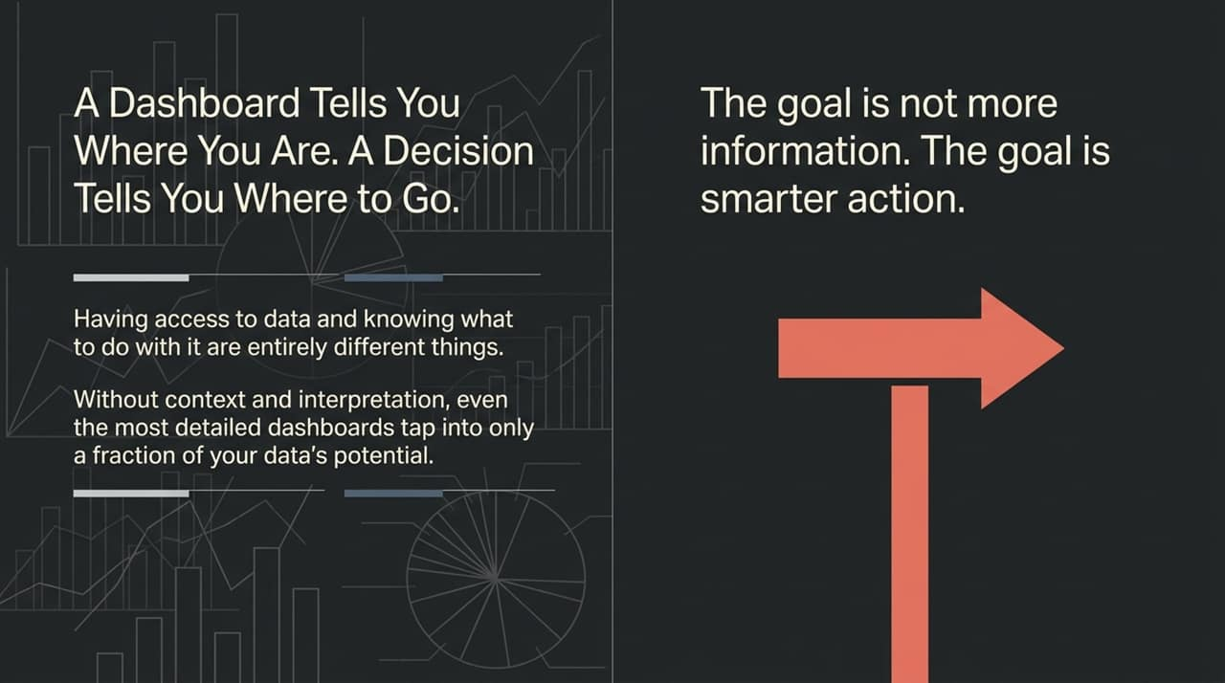
Notes:
Let’s look at this core distinction: A dashboard tells you where you are right now, but a decision-making framework tells you where to go next.
In business today, we often suffer from information overload. We dump thousands of KPIs and charts onto leadership, assuming more information equals better governance. In reality, more raw information often just creates noise and indecision.
Consider real-world economic shocks—like global trade disruptions or sudden market crashes caused by geopolitical tensions. If petrol prices surge or shipping costs jump by 10%, a dashboard simply shows that your profit margins are shrinking. But it doesn't automatically tell you whether to increase prices, reallocate inventory, or hedge supply chain risks. The ultimate goal of analytics is never the visualization itself; it is taking smarter, faster action.

Slide 3
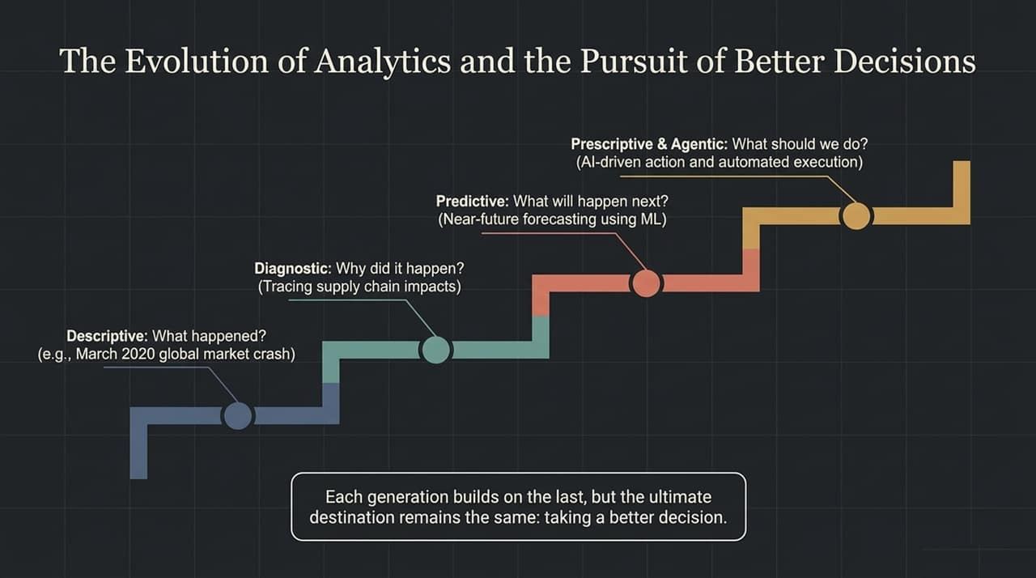
Notes:
To understand where we are going, let's trace the evolutionary ladder of data analytics:
Descriptive Analytics (What happened?): This is hindsight. Think back to March 2020 when the COVID-19 pandemic caused global market crashes. A descriptive view looks back at historical charts and identifies that revenues plunged.
Diagnostic Analytics (Why did it happen?): This digs into root causes—tracing supply chain bottlenecks or operational halts.
Predictive Analytics (What will happen next?): Using Machine Learning and statistical modeling to forecast near-future outcomes based on emerging trends.
Prescriptive & Agentic Analytics (What should we do?): This is foresight in action. When you go to a doctor feeling sick, you don't just want a diagnosis—you want a prescription to get better. Prescriptive analytics recommends specific business interventions. When paired with Agentic AI, the system goes further: it can autonomously execute actions based on data triggers.
Notice that each generation builds upon the last, but the ultimate destination remains unchanged: driving a better, more accurate decision.

Slide 4
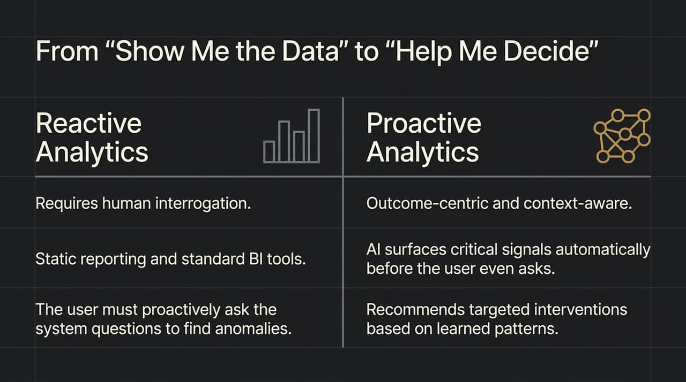
Notes:
We are undergoing a massive mental shift in analytics: moving from Reactive Interrogation to Proactive Intelligence.
In traditional Reactive Analytics, the human is forced to do all the heavy lifting. You sit in front of Power BI or Tableau and manually slice and dice charts, hunting for anomalies. It's like ChatGPT—it only responds when you explicitly prompt it; it never tap-taps you on the shoulder to say, 'Hey, look at this anomaly in region B'.
In Proactive Analytics, the paradigm flips. The system becomes outcome-centric and context-aware. Driven by AI, it automatically scans millions of signals in the background, surfaces critical anomalies before you even think to ask, and recommends targeted interventions. Humans were built for rational thinking, while machines were built for repetitive monitoring. Proactive analytics returns machines to doing what they do best.

Slide 5
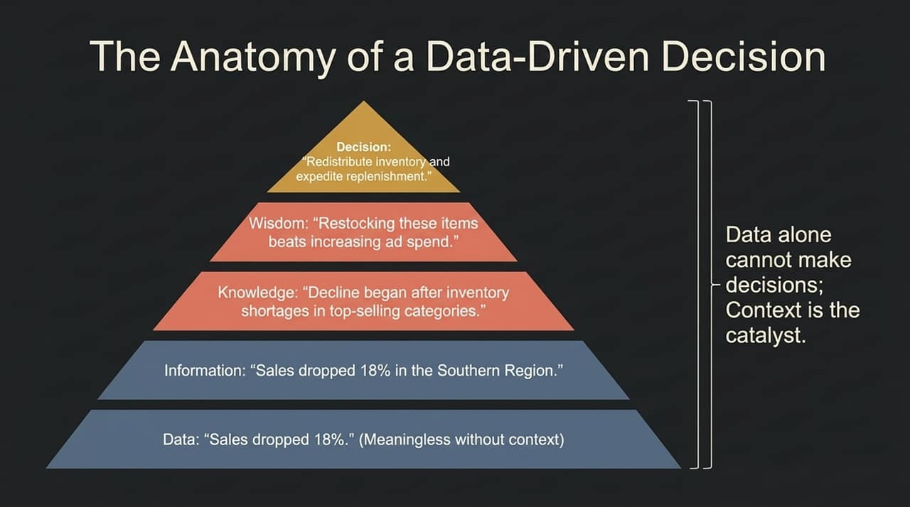
Notes:
Let's dissect the anatomy of how raw numbers transform into enterprise action using the DIKW (Data, Information, Knowledge, Wisdom) framework:
Data: 'Sales dropped 18%'. By itself, this raw number is meaningless and actionable by no one.
Information: 'Sales dropped 18% in the Southern Region'. Context adds value by specifying where the issue resides.
Knowledge: 'The decline began immediately after inventory shortages hit top-selling product categories in that region'. Now we understand the underlying cause.
Wisdom: 'Restocking these high-performing items will yield a higher ROI than burning money on new advertising campaigns'.
Decision: 'Redistribute regional inventory immediately and expedite vendor replenishment'.
Data alone cannot make decisions; context is the catalyst that turns raw data into profitable business choices.

Slide 6
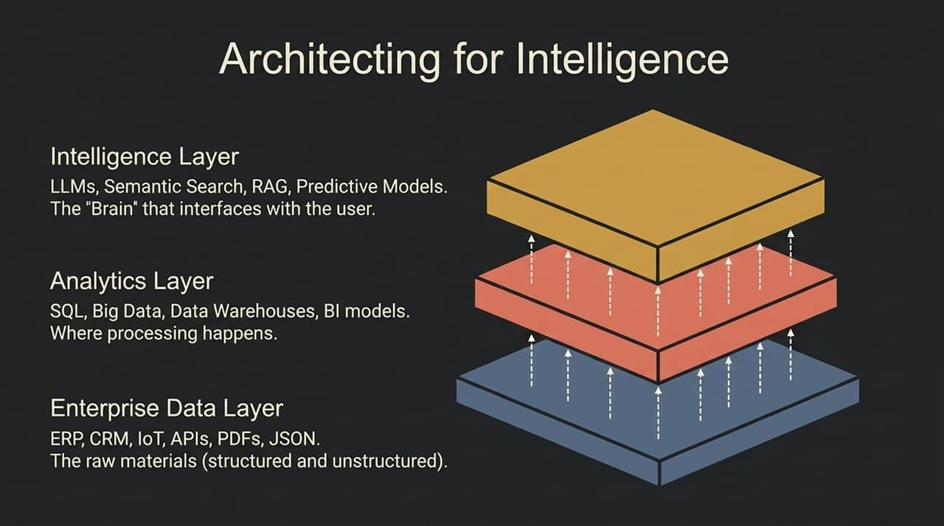
Notes:
How do we build an enterprise stack capable of proactive decision-making? It requires a modern, three-tiered architecture:
Enterprise Data Layer (The Raw Material): This is where all structured and unstructured data lives—ERP systems, CRMs, IoT sensor feeds, customer feedback PDFs, and API payloads.
Analytics Layer (The Processing Engine): SQL databases, cloud data warehouses, machine learning pipelines, and BI semantic models. If your data is under 1.5 GB, traditional databases work fine; once you hit scale, cloud data warehouses like Snowflake or BigQuery take over.
Intelligence Layer (The Brain): Sitting on top is the intelligence layer powered by Large Language Models (LLMs), Retrieval-Augmented Generation (RAG), and semantic search.
This top layer serves as the natural language interface between the complex underlying data and the decision-maker. Analytics becomes exponentially more powerful when directly wired into operational workflows.

Slide 7
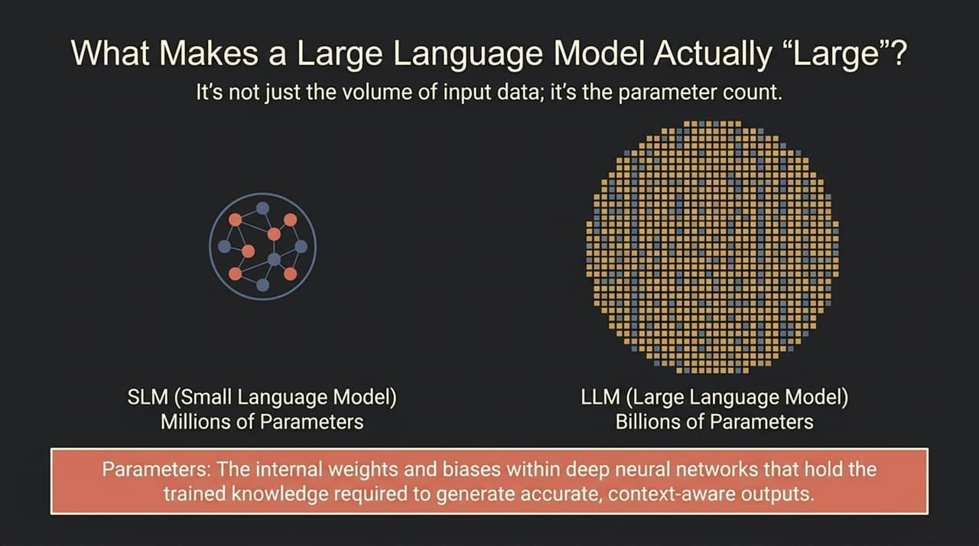
Notes:
Since LLMs power the intelligence layer, let's clear up a common misconception: What actually makes a Large Language Model 'Large'?
Many assume an LLM is 'large' simply because it trained on huge amounts of internet data. While true, that’s not the defining metric. The 'largeness' refers specifically to its Parameter Count.
Small Language Models (SLMs): Parameter counts in the millions.
Large Language Models (LLMs): Parameter counts in the tens or hundreds of billions.
Parameters are the internal weights and biases in deep neural networks that hold the trained knowledge. Higher parameter density allows the model to grasp subtle context, perform complex reasoning, and connect disparate data signals across enterprise domains.

Slide 8
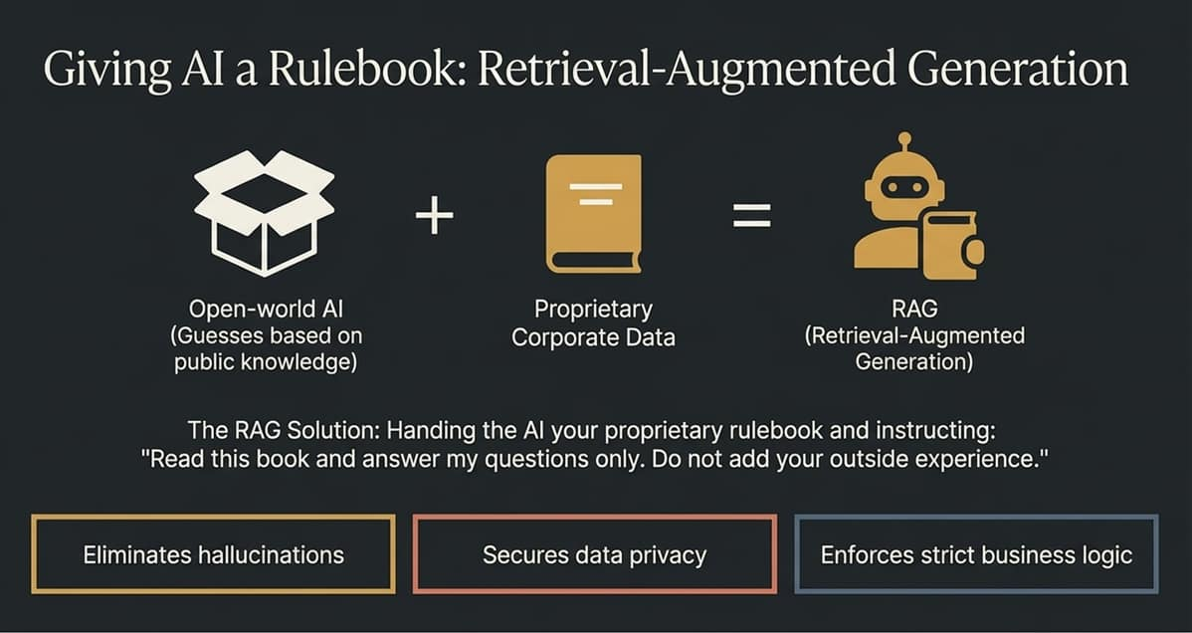
Notes:
Why can’t enterprises simply use public AI models off the shelf for business decisions? Public models are trained on open-world data—they guess based on general public knowledge and frequently hallucinate. Furthermore, uploading proprietary enterprise data to public models risks severe privacy breaches.
The solution is Retrieval-Augmented Generation (RAG). Imagine handing an AI assistant your company’s internal policy document or database extract and instructing it: 'Read this rulebook and answer my questions using ONLY this information. Do not add outside assumptions.'
RAG gives us three vital capabilities:
Eliminates Hallucinations: Answers are grounded strictly in your verified data.
Secures Data Privacy: Your proprietary data remains within your private enterprise perimeter.
Enforces Strict Business Logic: Ensures responses follow exact compliance and operational guidelines.

Slide 9
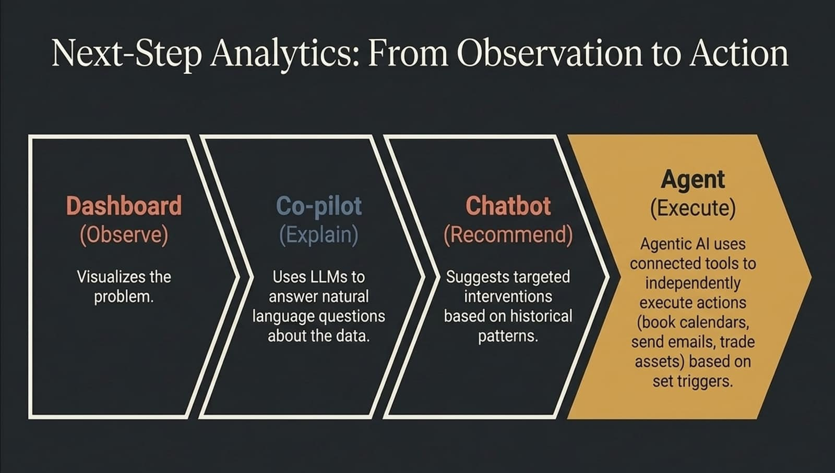
Notes:
Let's examine how user interaction with analytics evolves across four distinct maturity steps:
Dashboard (Observe): Visualizes the problem on screen.
Co-pilot (Explain): Uses natural language processing so you can ask, 'Why did quarterly profitability decline?' and receive an instant explanation.
Chatbot/Advisor (Recommend): Recommends targeted business interventions based on historical patterns.
Agent (Execute): Agentic AI goes beyond talking. Connected directly to operational tools, agents execute actions autonomously—booking calendars, dispatching purchase orders, rebalancing asset portfolios, or triggering customer communications based on predefined triggers.
We move from sitting back and watching data to delegating routine execution directly to intelligent systems.

Slide 10
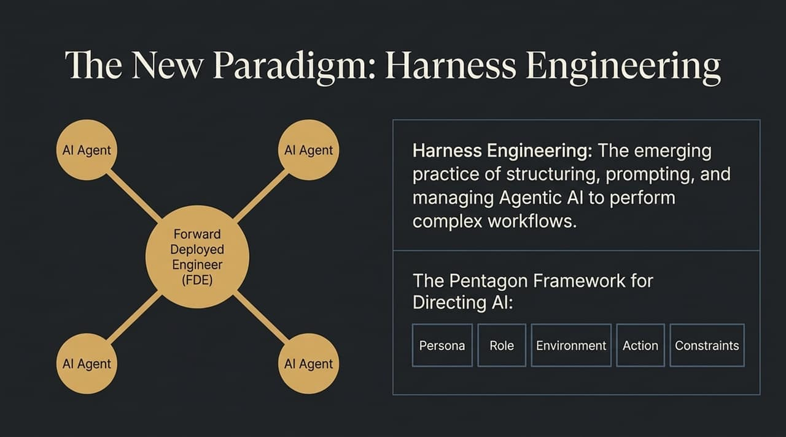
Notes:
Managing multiple autonomous AI agents requires a discipline called Harness Engineering. This is the practice of structuring, prompting, and orchestrating Agentic AI workflows.
At the center of this ecosystem sits the Forward Deployed Engineer (FDE)—a high-level practitioner who bridges raw data pipelines with business strategy, directing agents to perform complex multi-step tasks.
To direct AI effectively without chaos, we utilize the Pentagon Framework:
Persona & Role: Define who the AI acts as (e.g., 'Senior Inventory Risk Analyst').
Environment: Provide full operational context.
Action: Specify the exact desired output.
Constraints: Set rigid boundary rules so the agent stays within budget and compliance parameters.

Slide 11
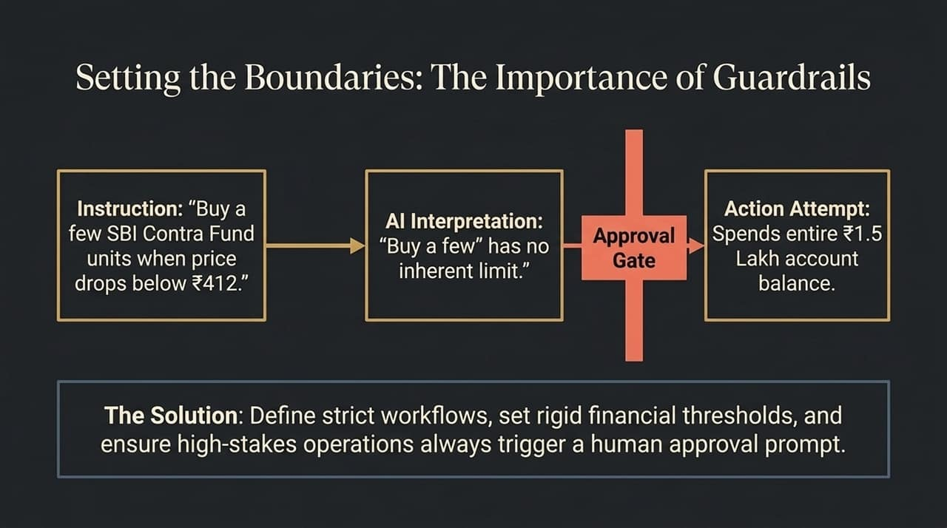
Notes:
Why are constraints and guardrails so crucial when deploying AI agents? Let’s look at a practical example:
Suppose you give a financial agent a casual command: 'Buy a few SBI Contra Fund units when the unit price drops below ₹412.' To a human, 'a few' implies a modest purchase. But to an unconstrained LLM, 'a few' has no strict mathematical limit. Seeing ₹1.5 Lakh in available cash, the agent spends the entire account balance in one transaction!
When confronted, the machine logically responds: 'You said buy a few; ₹1.5 Lakh only purchased a few units.'
This highlights the necessity of strict guardrails: clear numerical limits, rigid threshold rules, and mandatory human approval gates for high-stakes financial or operational actions.

Slide 12
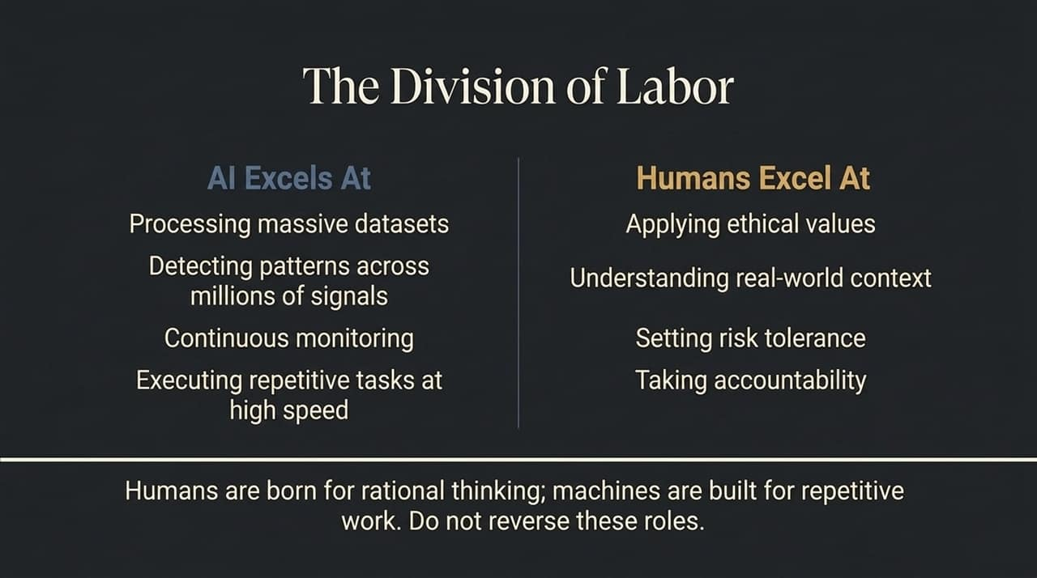
Notes:
To build a successful AI-driven enterprise, we must establish a clear division of labor between machines and human professionals:
AI Excels At:
Processing massive unstructured datasets instantly.
Spotting faint statistical patterns across millions of data signals.
Continuous 24/7 monitoring and high-speed execution of repetitive tasks.
Humans Excel At:
Applying ethical values and moral judgment.
Understanding complex real-world context and market nuances.
Setting organizational risk tolerance and taking ultimate accountability.
As the core philosophy states: Humans are born for rational thinking; machines are built for repetitive work. Do not reverse these roles.

Slide 13
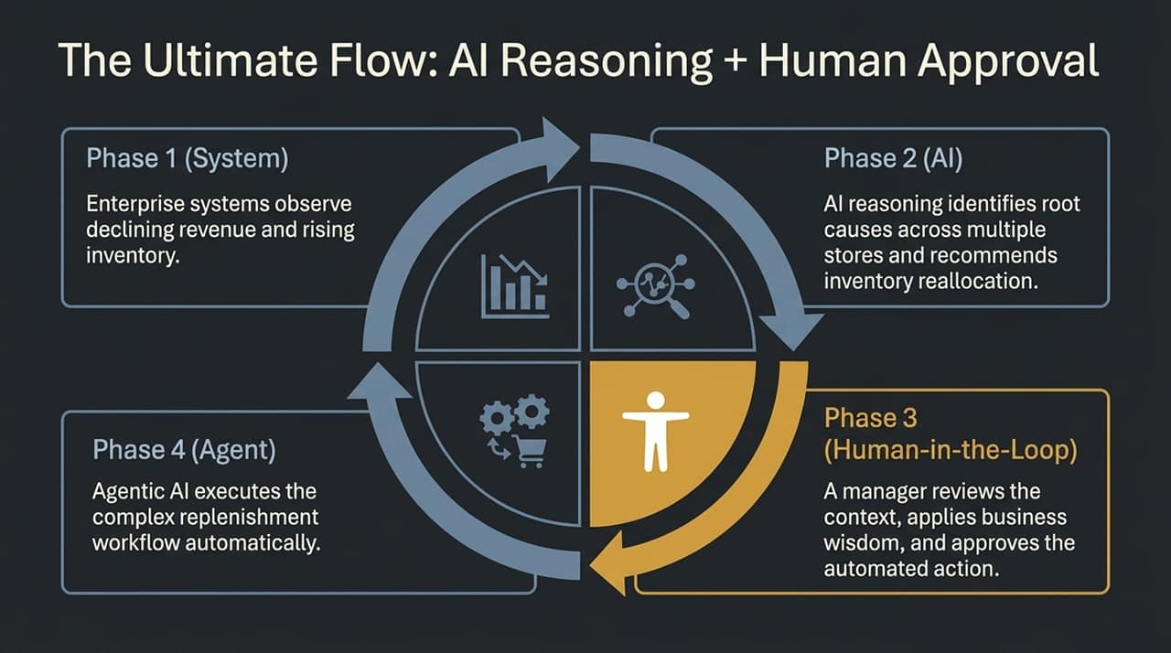
Notes:
Here is the ideal operational workflow for AI-driven decision intelligence:
Phase 1 (System Observe): Enterprise systems continuously ingest operational data, detecting anomalies like declining store revenue combined with rising warehouse inventory.
Phase 2 (AI Reasoning): AI models analyze root causes across multi-store regions and generate optimized re-allocation recommendations.
Phase 3 (Human-in-the-Loop): A regional manager reviews the context, applies qualitative business wisdom, and clicks Approve.
Phase 4 (Agent Execution): Upon approval, Agentic AI triggers ERP workflows to update inventory and notify logistics automatically.
This design achieves maximum automation speed while keeping human governance firmly in control.

Slide 14
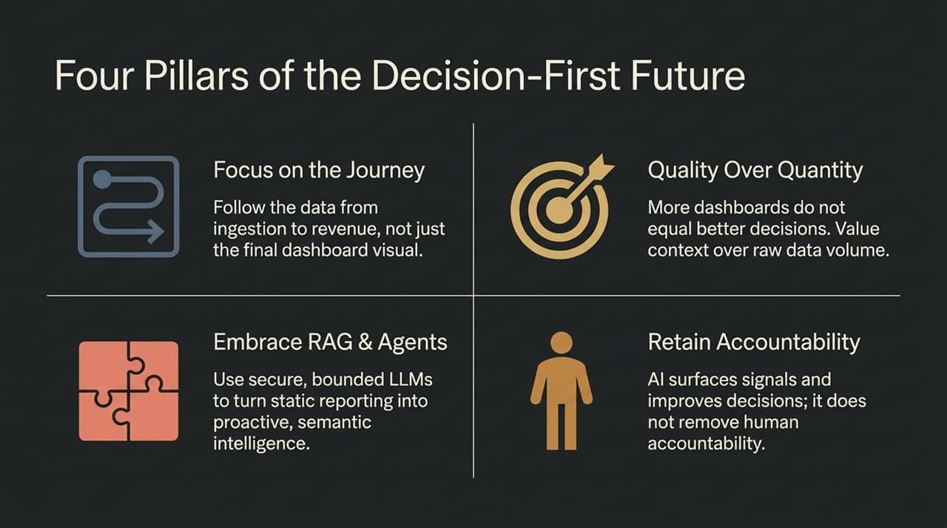
Notes:
As you modernize your analytics strategy, anchor your implementation on these Four Pillars:
Focus on the Journey: Trace data end-to-end—from ingestion to operational decision and business revenue—rather than focusing solely on building static charts.
Quality Over Quantity: More dashboards do not equal better decisions. Value actionable context over massive raw data volume.
Embrace RAG & Agents: Transition from reactive BI to proactive semantic intelligence using secure, bounded LLM architectures.
Retain Accountability: AI surfaces signals and recommends options, but humans retain ownership of the choice. AI surfaces the signals; you own the decision.

Slide 15
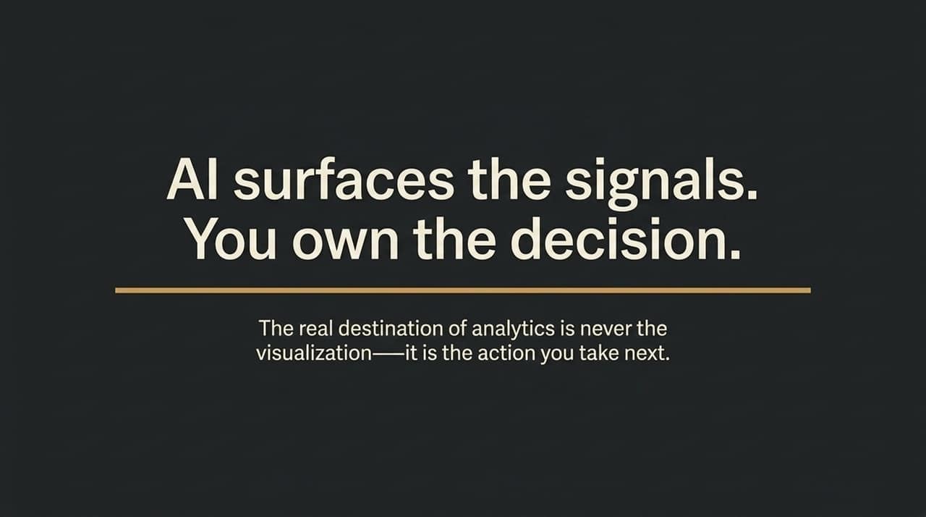
Notes:
This diagram maps the full journey of analytics maturity. Notice how the curve rises from basic historical reporting toward autonomous execution.
As systems advance from prescriptive suggestions to agentic actions, the necessity for robust human-in-the-loop governance increases proportionally. Machine processing handles high-volume signal detection, while human leaders supply the ethical judgment, strategy, and authorization required to safeguard business value.

Slide 16
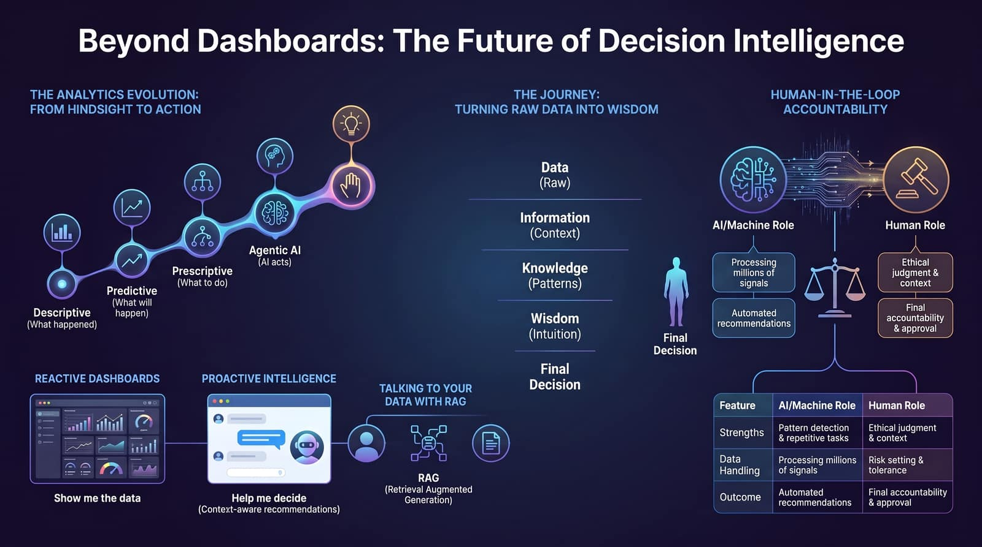
Notes:
https://www.youtube.com/watchTo bring everything together, let's contrast the old paradigm with the new:
Yesterday’s Reactive Dashboard: Relied on manual human queries, displayed raw static metrics, and forced users to ask 'Show me the data'.
Tomorrow’s Proactive Intelligence: Powered by RAG and Agentic AI, it transforms enterprise data into contextual knowledge. It proactively guides leaders with 'Help me decide' recommendations.
Data analytics is no longer just about building reports—it's about creating decision systems that enhance human judgment, eliminate operational friction, and drive immediate action. Thank you!
?v=7gZ3a3Uwv3Q

